Slide 1
NFT Gate
May 23, 2022

Slide 2


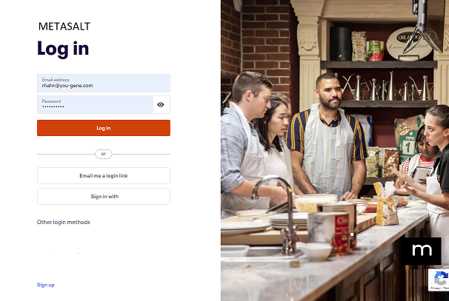
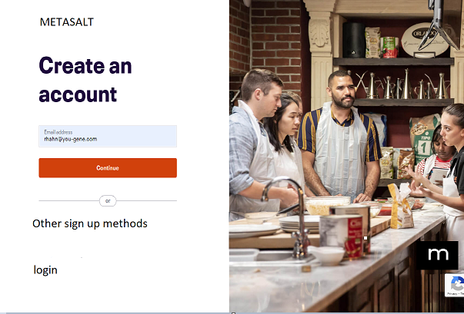
Search NFT gates …
+ CREATE NFT
+ CREATE NFT GATE
+BUY $METASALT
BUY/SELL NFTs
LOGIN
SIGNUP
If not logged in
If not logged in
Menu bar BEFORE LOGIN

Slide 3
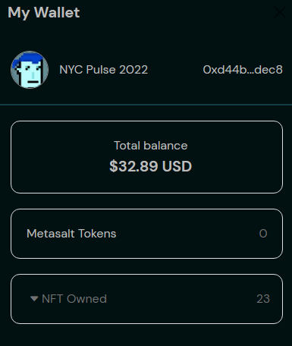
Search NFT Gates …
+ CREATE NFT
+ CREATE NFT GATE
+BUY $METASALT
BUY/SELL NFTs
PROFILE
MY NFTS
All
Brands
Collections
Authenticate
My NFT Gates
My Market
My Brands
My Collections
My History
My Settings
Logout
My NFTs
Search box is same
But now searching NFT GATES
Remove menu
Just need a + sign that redirects to Create NFT page
No Brand and Collections submenu. These items will be in flow
New NFT Gate
Just a “+” sign
Redirects to new create NFT Gate page
Just a “+” sign
No button
Redirects to “Trade
$Metasat” token page
Links to entire marketplace
Links to marketplace filtered just on brands
Links to marketplace filtered just on collections from all brands
*Ranking and Social can stay just on home page w/no menu
Add “My NFT Gates"
Stays same, but change “My Wallet” to “My NFTs”
Menu bar AFTER LOGIN
DOCS
Move Docs Button to footer

Slide 4
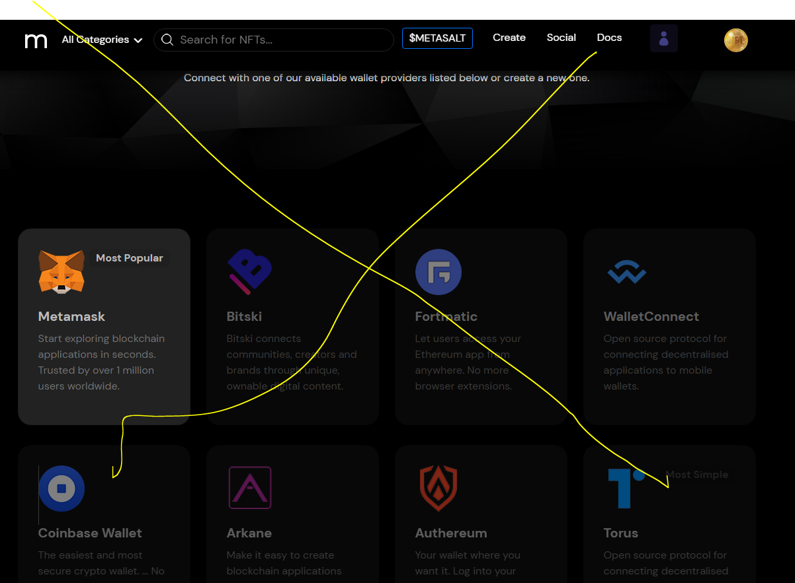
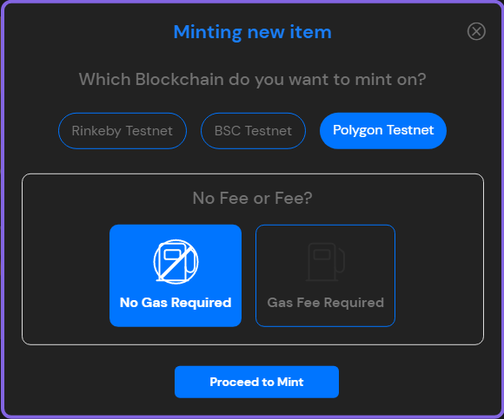
Search NFT gates …
+ CREATE NFT
+ CREATE NFT GATE
+BUY $METASALT
BUY/SELL NFTs
PROFILE
MY NFTS
If passwordless, check if wallet address is in db
If not, popup saying “you can browse and use all features. However, to buy/sell and create, you must create Metamask account
Link to Download Metamask
Message – Only chrome supported at this time
Delete this page
Check if logged into Metamask

Slide 5
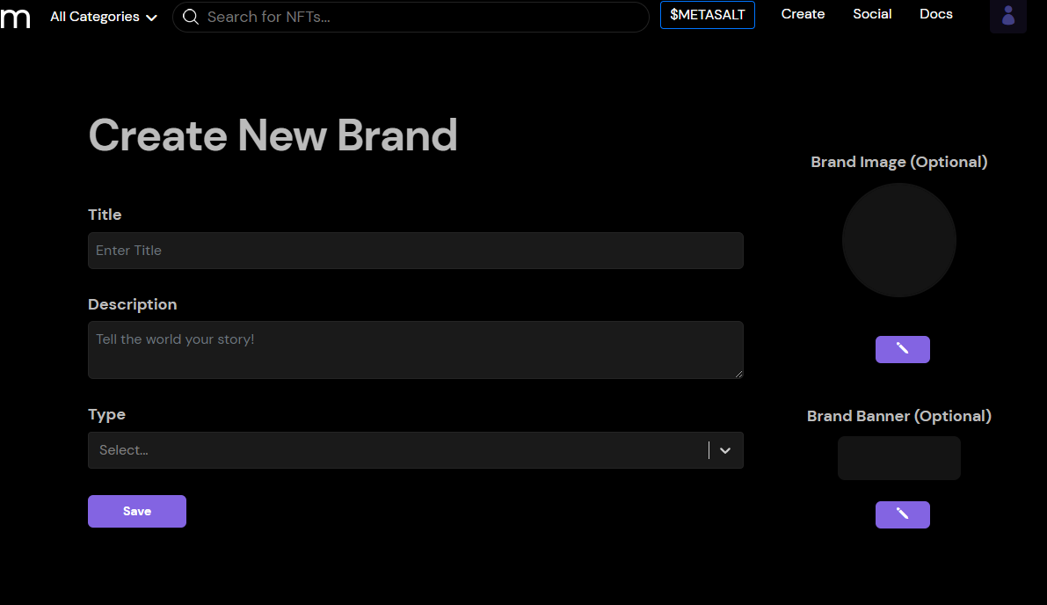
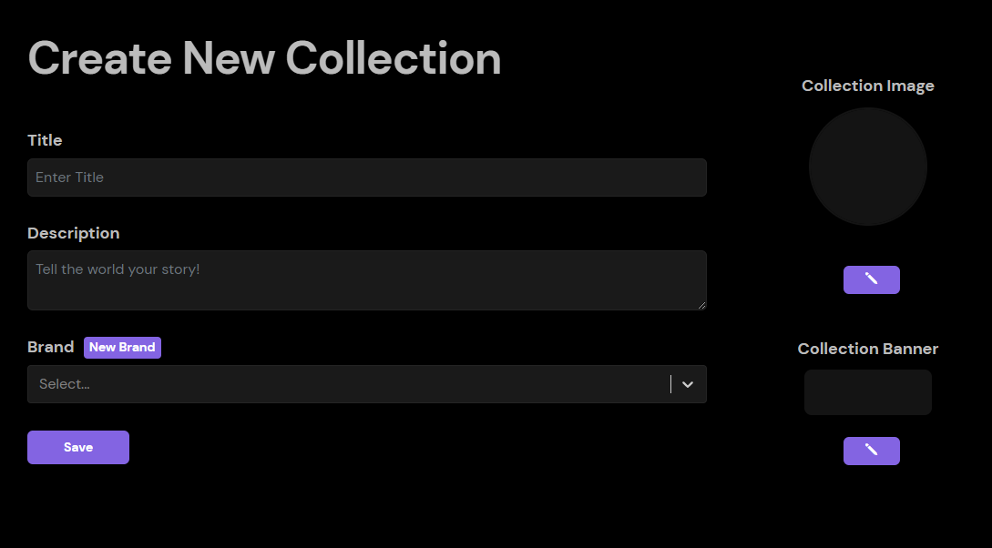
Search NFT gates …
+ CREATE NFT
+ CREATE NFT GATE
+BUY $METASALT
BUY/SELL NFTs
PROFILE
MY NFTS
All NFTs
BRAND
Details
Rolex
Gucci
Create
You must create at least one brand
Name your NFT
COLLECTION
You must create at least one collection
NFT Name*
Be clear and descriptive
Submariner
Dayjust
Diamonds
Create
0/35
Describe your NFT
NFT*
Be clear and descriptive
Details
Image
0/35
Authentication (optional)
Number
Price
Number of NFTs that should be minted
Must range from 1 to 10,000
Royalties
Discard
Save & Continue

Slide 6
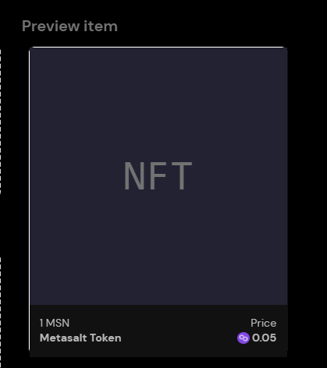
Search NFT gates …
+ CREATE NFT
+ CREATE NFT GATE
+BUY $METASALT
BUY/SELL NFTs
PROFILE
MY NFTS
All NFTs
Image
BRAND
Diamond NFT
Rolex
COLLECTION
Upload NFT Image
Submariner
PNG, JPG, FIG, WEBP, MPR3, Max 200B
Browse
Details
Image
Authentication (optional)
Price
Royalties
Discard
Save & Continue

Slide 7
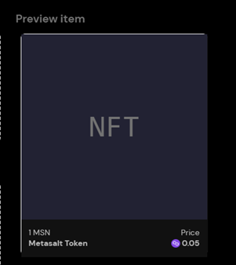
Search NFT gates …
+ CREATE NFT
+ CREATE NFT GATE
+BUY $METASALT
BUY/SELL NFTs
PROFILE
MY NFTS
All NFTs
Authentication
BRAND
Diamond NFT
Rolex
Should I add authentication. Link here to find out why it’s a good idea.
COLLECTION
Submariner
Upload QR code (Optional)
Scan an Image File
Request Camera Permission
Generate a random QR code for me. So, I and others can quickly and easily authenticate this NFT.
Details
CREATE QR Code
Image
Authentication (optional)
Price
Royalties
Discard
Save & Continue

Slide 8
Search NFT gates …
+ CREATE NFT
+ CREATE NFT GATE
+BUY $METASALT
BUY/SELL NFTs
PROFILE
MY NFTS
All NFTs
Authentication
BRAND
Diamond NFT
Rolex
Should I add authentication. Link here to find out why it’s a good idea.
COLLECTION
Submariner
Upload QR code (Optional)
Scan an Image File
Request Camera Permission
Generate a random QR code for me. So, I and others can quickly and easily authenticate this NFT.
Details
CREATE QR Code
Image
Authentication (optional)
SAVE QR Code
Price
Royalties
Discard
Save & Continue

Slide 9
Search NFT gates …
+ CREATE NFT
+ CREATE NFT GATE
+BUY $METASALT
BUY/SELL NFTs
PROFILE
MY NFTS
All NFTs
BRAND
Price
Rolex
Enter starting price
COLLECTION
Submariner
0.05
Details
Image
Authentication (optional)
Price
Royalties
Discard
Save & Continue

Slide 10
Search NFT gates …
+ CREATE NFT
+ CREATE NFT GATE
+BUY $METASALT
BUY/SELL NFTs
PROFILE
MY NFTS
All NFTs
BRAND
Royalties
Rolex
How much will each sale return to original minter
Always free for lazy minting. Click for a detailed explanation of Lazy minting
COLLECTION
Submariner
Suggested 3%. Max is 50%
Details
Image
Authentication (optional)
Price
Royalties
Discard
Save & Continue

Slide 11
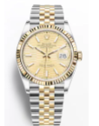
Search NFT gates …
+ CREATE NFT
+ CREATE NFT GATE
+BUY $METASALT
BUY/SELL NFTs
PROFILE
MY NFTS
Lazy minting does not cost gas and is freely added to your wallet address. However, once the NFT is sold, a 3% fee is incurred.*
*Changes from null address to buyer’s address. 3% fee to Metasalt. Remaining to minter-brand.
All NFTs
Listing of all NFTs you have created
Diamonds
Brand
Collection
Minted
Sold
Max
LAZY MINT NOW
Rolex
Dayjust
550
550
1
Name1
Brand
Collection
Minted
Sold
Max
03/06/2022
Gucci
Handbag
100
10,000
56
Name2
Brand
Collection
Minted
Sold
Max
04/13/2022
Rolex
Midjust
100
45
10,000
+CREATE NFT

Slide 12
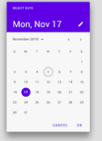
Search NFT gates …
+ CREATE NFT
+ CREATE NFT GATE
+BUY $METASALT
BUY/SELL NFTs
PROFILE
MY NFTS
BRAND
All NFT Gates
Rolex
Gucci
Create
You must create at least one brand
Details
COLLECTION
You must create at least one collection
Submariner
Dayjust
Diamonds
Create
Name your NFT gate
NFT Gate Name*
Be clear and descriptive
NFT GATE TYPE
Memberships
Events
Media
Products
0/35
Describe what it does and why. Add details to get them excited
You must finish to publish
NFT Gate Name*
Be clear and descriptive
STATUS
Date Picker
Draft
Scheduled
Publish
Unpublish
You must finish to publish
0/150
Details
NFTs
Content
Scroll Down

Slide 13
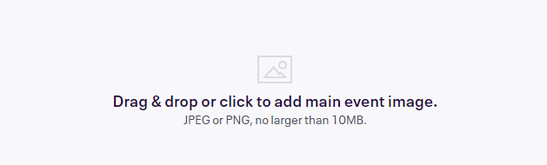
Search NFT gates …
+ CREATE NFT
+ CREATE NFT GATE
+BUY $METASALT
BUY/SELL NFTs
PROFILE
MY NFTS
All NFT Gates
BRAND
Rolex
Details
COLLECTION
This is the first image attendees will see at the top of your listing. Use a high quality image: 2160x1080px (2:1 ratio).
Submariner
NFT GATE TYPE
Memberships
STATUS
Draft
Details
NFTs
Content
Discard
Save & Continue

Slide 14
Search NFT Gates …
+ CREATE NFT
+ CREATE NFT GATE
+BUY $METASALT
BUY/SELL NFTs
PROFILE
MY NFTS
NFT GATE TYPE
All NFT Gates
Memberships
NFTs
STATUS
Rolex Membership NFT Gate
Draft
Select the NFTs that give access to this NFT Gate
BRAND
+ADD NFT
Rolex
COLLECTION
Diamonds
Minted
Sold
02/12/2022
100
89
DayJust
AND/OR
Diamonds2
02/13/2022
Minted
Sold
100
56
Details
AND/OR
NFTs
Diamonds3
02/14/2022
Minted
Sold
100
45
Content
Discard
Save & Continue

Slide 15
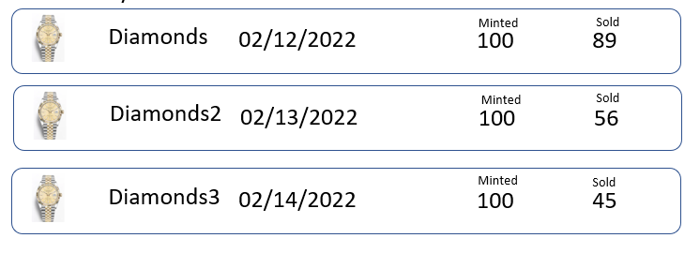
Search NFT Gates …
+ CREATE NFT
+ CREATE NFT GATE
+BUY $METASALT
BUY/SELL NFTs
PROFILE
MY NFTS
NFT GATE TYPE
All NFT Gates
Memberships
NFTs
Rolex Membership NFT Gate
STATUS
+Add your own NFT
Draft
Chris: add flow for adding contract address, tokenID, pulling all NFTs using cloud function on back end, and serving just first 2 or 3 with SELECT – ALL option
Select the NFTs that give access to this NFT Gate
ETH
BSC
Poly
BRAND
+ADD NFT
Rolex
COLLECTION
Diamonds
Minted
Sold
+Add Existing NFT
02/12/2022
100
89
DayJust
AND/OR
Diamonds2
02/13/2022
Minted
Sold
100
56
Details
AND/OR
NFTs
Diamonds3
02/14/2022
Minted
Sold
100
45
Content
+Create NFT
Discard
Save & Continue

Slide 16
Search NFT Gates …
+ CREATE NFT
+ CREATE NFT GATE
+BUY $METASALT
BUY/SELL NFTs
PROFILE
MY NFTS
NFT GATE TYPE
All NFT Gates
Memberships
Content
STATUS
Rolex Membership NFT Gate
Draft
Add the content that is revealed to NFT Owners
BRAND
+CREATE CONTENT
Rolex
COLLECTION
YouTube
02/12/2022
DayJust
Discord
03/05/2022
Details
NFTs
QR code
04/13/2022
Content
Discard
Save & Continue

Slide 17
Search NFT Gates …
+ CREATE NFT
+ CREATE NFT GATE
+BUY $METASALT
BUY/SELL NFTs
PROFILE
MY NFTS
NFT GATE TYPE
All NFT Gates
Memberships
Content
STATUS
Rolex Membership NFT Gate
Add Content
Draft
Add the content that is revealed to NFT Owners
BRAND
Content type
+CREATE CONTENT
Rolex
Events
Link
Media
Products
COLLECTION
YouTube
02/12/2022
DayJust
Discord
03/05/2022
Generate unique QR code for each wallet.
Wallet address changed to QR code
Only used once per event
Scanned by retailer/brand mobile application
Details
NFTs
QR code
04/13/2022
Content
Discard
Save & Continue

Slide 18
Search NFT Gates …
+ CREATE NFT
+ CREATE NFT GATE
+BUY $METASALT
BUY/SELL NFTs
PROFILE
MY NFTS
NFT GATE TYPE
All NFT Gates
Memberships
Content
STATUS
Rolex Membership NFT Gate
Draft
Add the content that is revealed to NFT Owners
BRAND
+CREATE CONTENT
Rolex
COLLECTION
YouTube
02/12/2022
DayJust
AND/OR
Discord
03/05/2022
AND/OR
Details
NFTs
QR code
04/13/2022
Content
AND/OR
Website
04/13/2022
Discard
Save & Continue

Slide 19
Search NFT Gates …
+ CREATE NFT
+ CREATE NFT GATE
+BUY $METASALT
BUY/SELL NFTs
PROFILE
MY NFTS
ALL NFT GATES
View
Edit
Copy URL
Copy NFT Gate
Delete
Listing of all NFT Gates you have created
Type
Brand
Collection
Date
Status
Membership NFT Gate 1
Membership
Rolex
Dayjust
02/12/22
Published
Type
Brand
Collection
Date
Status
Concert NFT Gate 1
Event
Gucci
HandBag
03/13/22
Draft
+CREATE NFT GATE

Slide 20


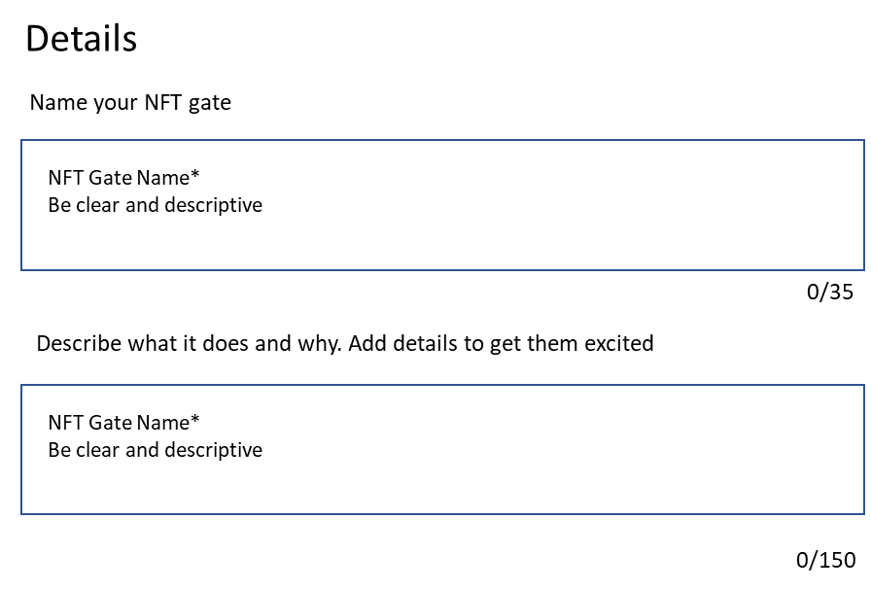
Search NFT Gates …
+ CREATE NFT
+ CREATE NFT GATE
+BUY $METASALT
BUY/SELL NFTs
PROFILE
MY NFTS
NFT GATE TYPE
All NFT Gates
Memberships
Dashboard
Rolex Brand
STATUS
Cool Membership NFT Gate
Submariner collection
Draft
BRAND
Published on 5/31/2022
Rolex
COLLECTION
NFTs Allowed
Views
DayJust
5
1,234
View NFTs
Details
Image
Share
NFTs
NFT Gate URL
Content
https://metasalt.io/6762000012111
Review
Scroll down and
Make each section editable

Slide 21
